Slide 1


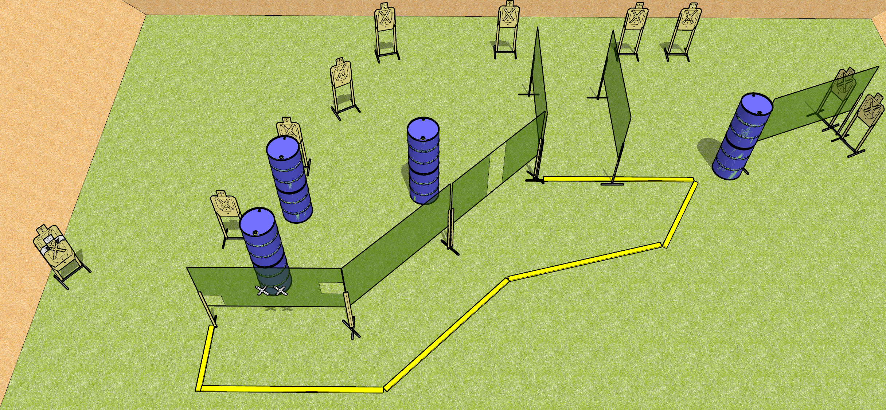
 | Dothan Gun Club – USPSA Match Reach for the Star Course Designer : Drew Coleman
START POSITION : Standing with both palms flat on marks. PCC shouldered, muzzle touching right side mark
GUN READY CONDITION : Pistol loaded and holstered. PCC shouldered, safety on, muzzle touching right side mark |  | SCORING: Comstock, 22 rounds TARGETS: 11 paper, 0 Steel SCORED HITS: Best 2 on paper, steel until down START-STOP: Audible, last shot RULES:
STAGE PROCEDURE: Engage targets as they become available from within the fault lines.

